Slide 1
PFO AND STROKE
Dr sajad ahmad tak ( DNB scholar)

Slide 2
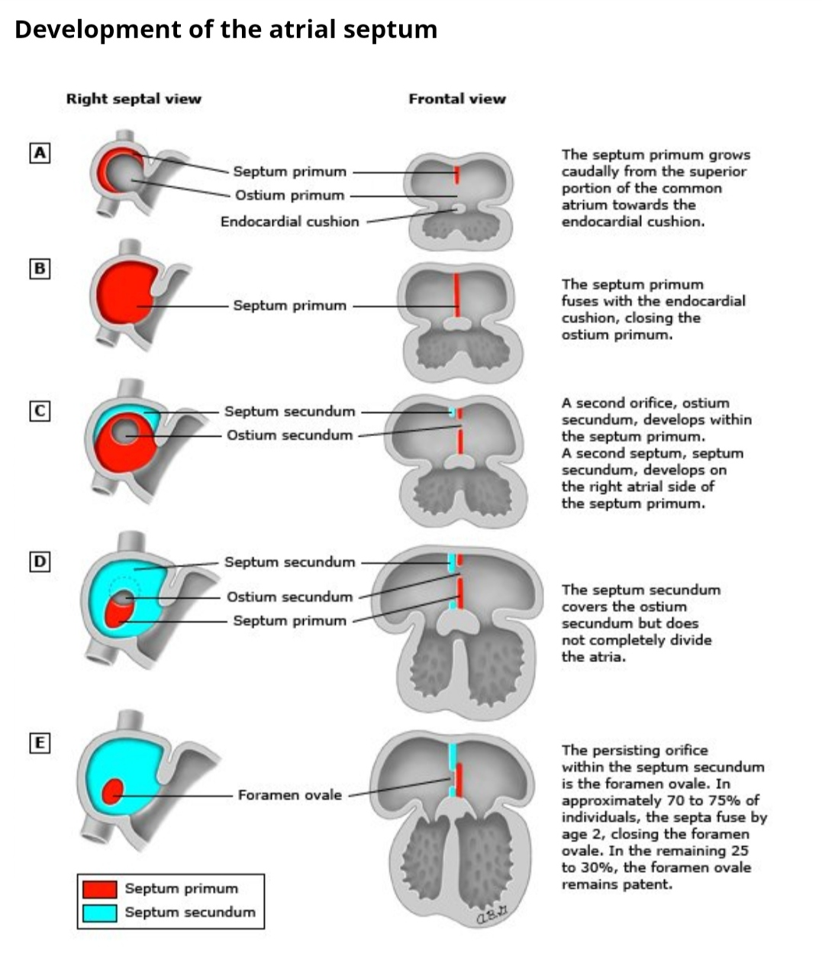

Slide 3
Prevalence ;
25 to 30 % in normal population.
patients with cryptogenic stroke
increased prevalence.
PFO-ASA study….around 45% pts had PFO.

Slide 4
Pathophysiology
Paradoxical emboli ( via right to left shunting)
Right to left shunting :
Rest
Transient ( valsalva maneuver …..straining , coughing , lifting heavy objects)

Slide 5
Diagnosis
TEE…with agitated saline contrast ( bubble study) along with colour doppler .
One TEE study of of 148 pts with PFO…Rt To Lt shunting ….57% at rest
….and 92% with straining or coughing.
Other methods.
TTE
TCD

Slide 6
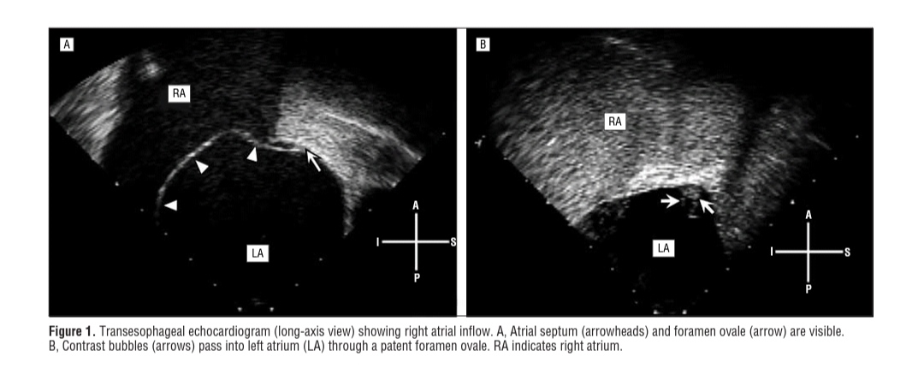

Slide 7
PFO size :
Grade 0,…. no microbubbles
Grade 1 (small)….1 to 5 microbubbles.
Grade 2 (moderate)….6 to 25 microbubbles
Grade 3 ( large )….> 25.

Slide 8
Is pFO the most likely mechanism of stroke
History :
what was pt. doing at time of stroke
Any risk of DVT (..prolonged immobility, long haul air travelet etc).
Is embolic stroke present :
Multiple vascular territories
Single wedge shaped infarct involving cortex and the underlying subcortical white matter.

Slide 9
Evaluation for Venous thromboembolism: ( with in 2 to 3 days).
Studies have shown low rates of proximal DVT ….10 to 22 %;
Reasons include ;
Incomplete evaluation
Small emboli ( may go undetected by conventional doppler)
Clot forms in the heart …leads, PFO tunnel
Resolved DVT
Clot may be lysed with thrombolytic therapy.

Slide 10
PFO risk assessment
ROPE SCORE …> 7…
PASCAL classification system….probability of stroke is associated with PFO;

Slide 11
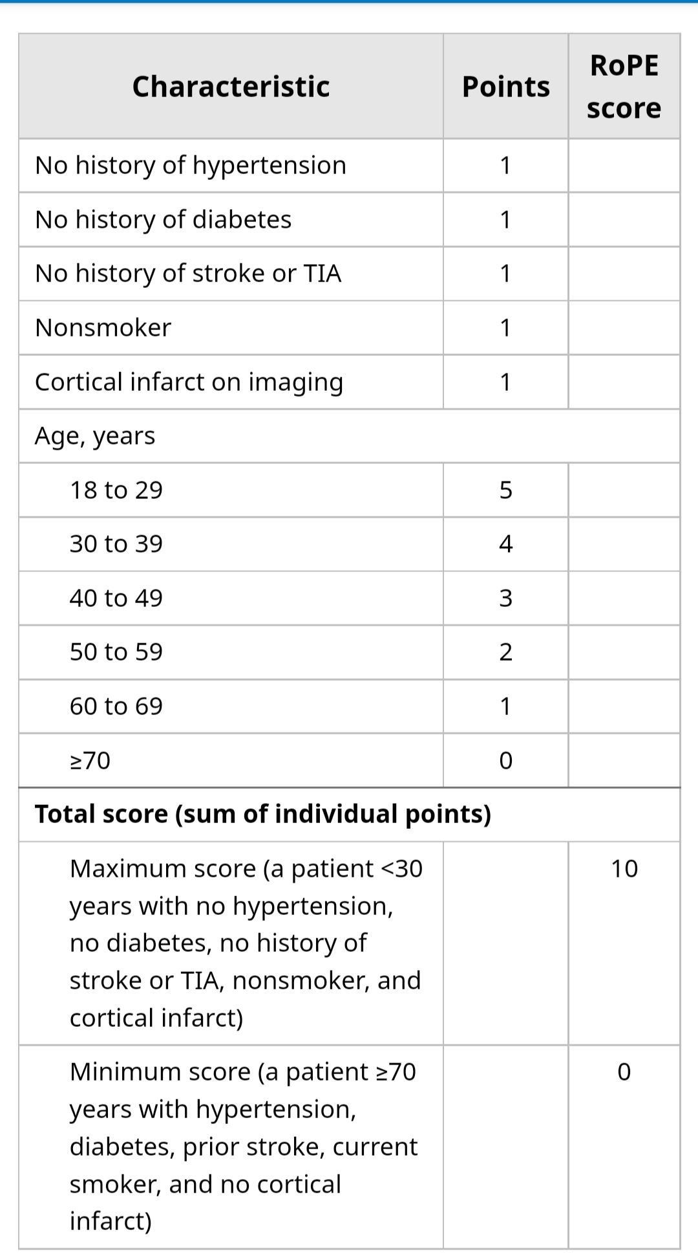
ROPE SCORE

Slide 12
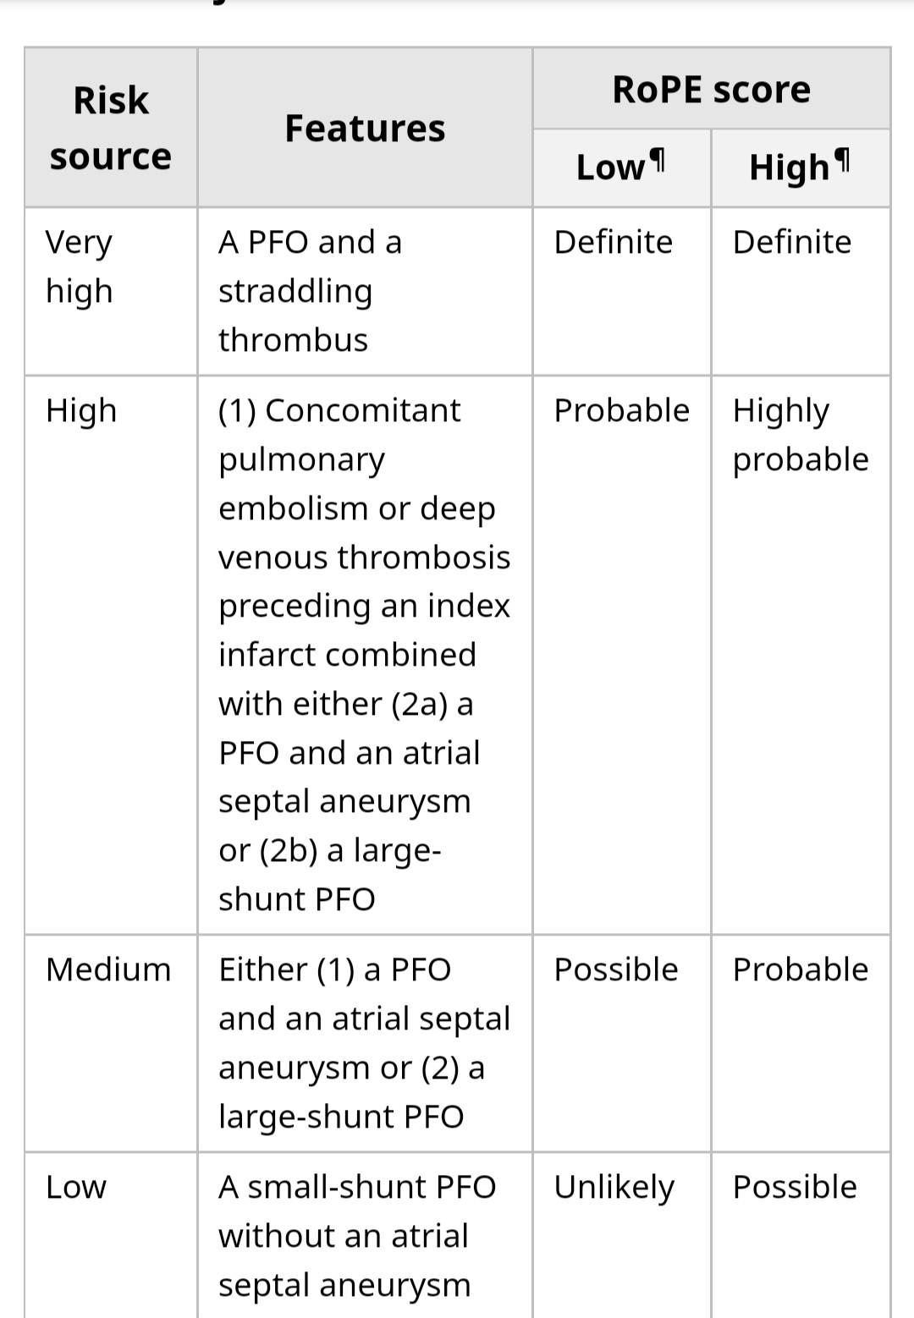
PASCAL classification

Slide 13
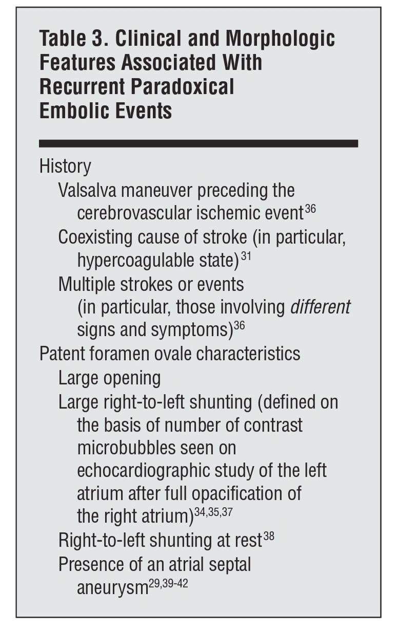

Slide 14
Management
To prevent recurrent stroke
Medical therapy ( antiplatlets or anticaugulation )
VS
PFO closure

Slide 15
6 Randomised Trials.
Inclusion criteria
18 to 60 yr
cryptogenic Stroke OR TIA .
PFO
primary outcome… recurrent ischemic stroke OR TIA.

Slide 16
PC (2000 TO 2009)
CLOSURE (2003 TO 2008)
RESPECT(2003 TO2011)
909 PATIENTS .
MULTICENTRE …USA AND CANADA
PFO CLOSURE(447) AND MEDICAL G (462).
2YR F/UP .
PRIMARY END POINT ( 5.5% VS 6.8% )
( P= 0.37).
CONCLUSION :NO SIGNIFICANT DIFFERENCE BETWEEN DEVICE CLOSURE AND MEDICAL THERAPY IN THE RATES OF PRIMARY ENDPOINT.
414 PATIENTS.
EUROPE,BRAZIL, CANADA AND AUSTRALIA
F/UP ..4YRS.
204 PFO CLOSURE VS 210 MEDICAL G.
3.4% VS 5.2% ( P=0.34)
980 PATIENTS.
USA AND CANADA
F/UP 2.6YRS
481 PFO CLOSURE VS 499 MEDICAL G
9PTS VS 16 PTS …( P=0.08)
NOT SIGNIFICANT

Slide 17
Close (2008 to 2014)
REDUCE (2008 to 2015)
Extended RESPECT
F/UP…..5.9yrs
Recurrent stroke ….
18 vs 28 pts.
(P=0.046).
CONCLUSION ; significant difference between closure group v and medical group.
Three groups..1;1;1.
France and Germany .
663 pts .with F/up ..53 months
No stroke in pfo closure (238)vs 14 pts in antiplatlet group. (p<0.001).
anticaugulant G ..3 (187) vs antiplatlet G 7 (174).
2:1 RATIO
Canada, Finland ,UK and USA.
664 pTS .
F/up 3.2 yrs
6 (441) ..vs 12 (223) developed recurrent stroke . (p=0.04).
AF …6.6% pts in PFO group.

Slide 18
DEFENCE-PRO TRIAL( May 2018)
SEPTEMBER 2011 UPTO OCTOBER 2017.
HIGH RISK PFO ( PFO WITH ASA , LARGE SIZE >2mm)
60 pts ..pfo closure vs medical group
f/up…2yrs
No stroke vs 5 ischemic strokes (medical G)
P=0.023

Slide 19
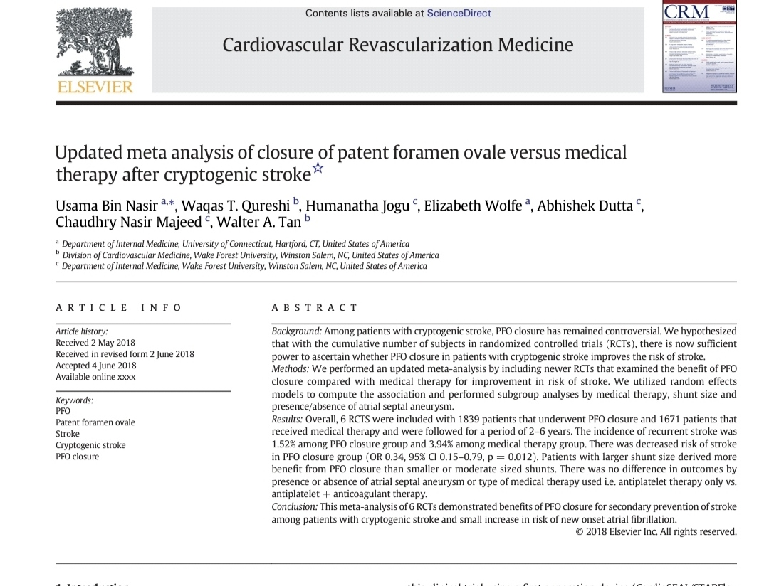

Slide 20
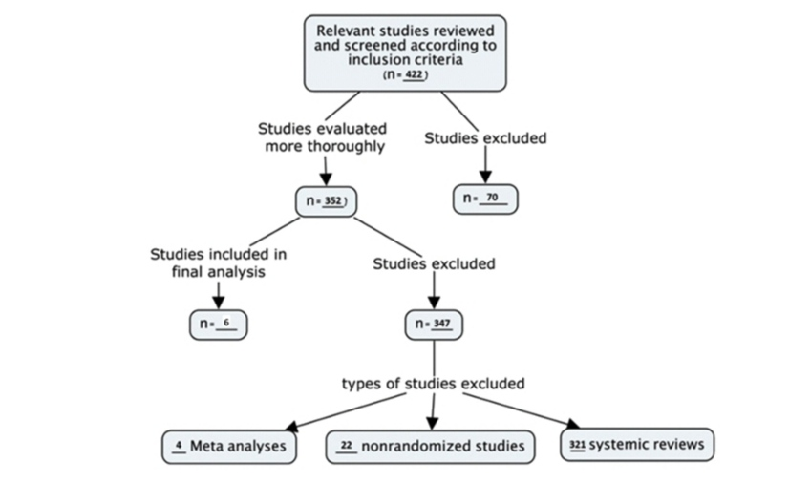

Slide 21
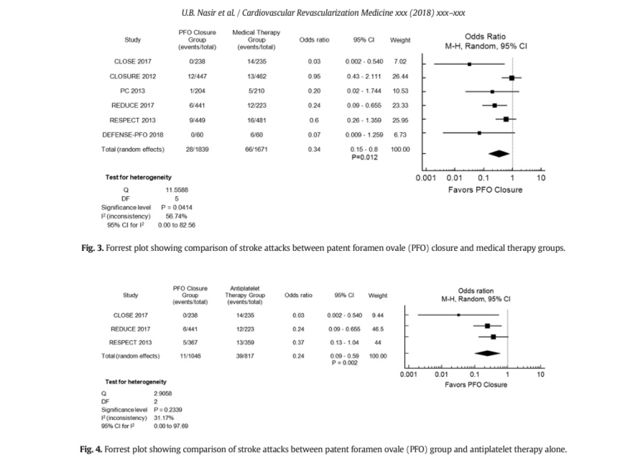

Slide 22
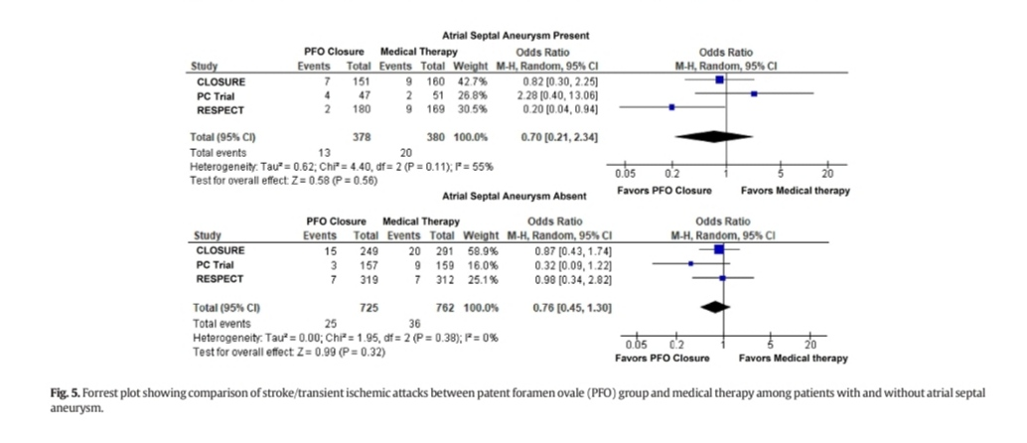

Slide 23
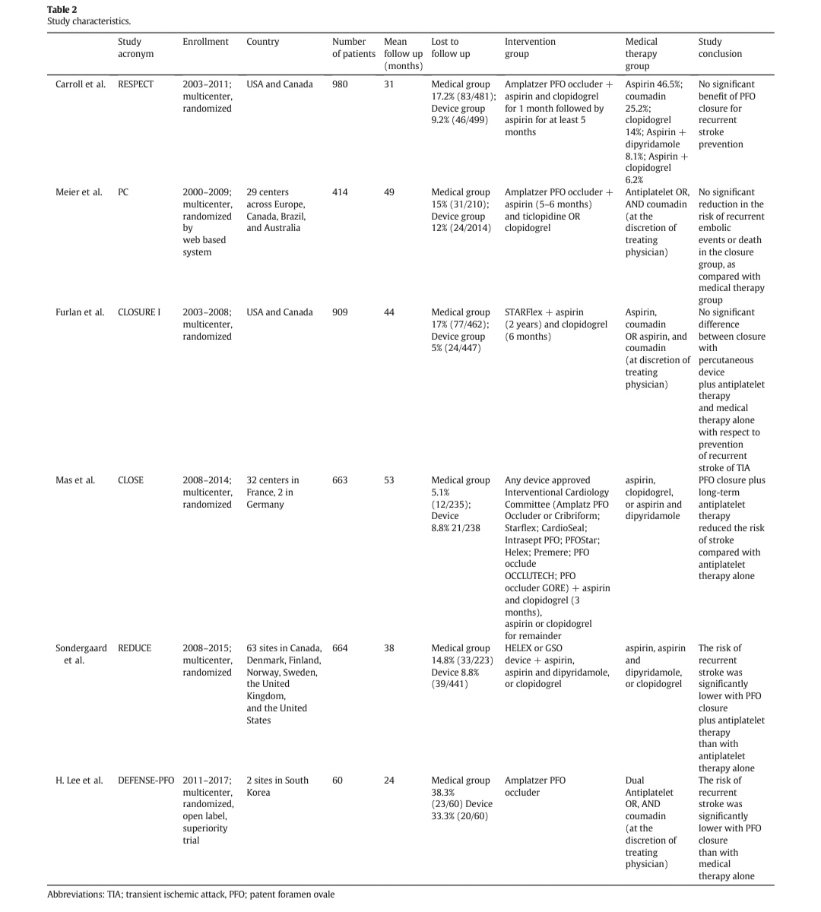

Slide 24
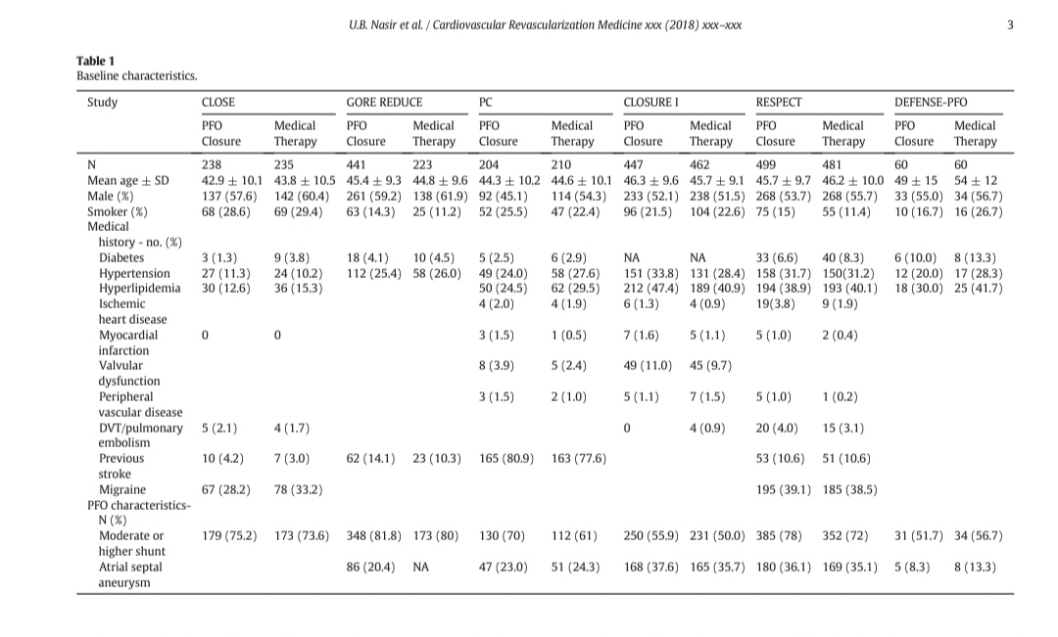

Slide 25
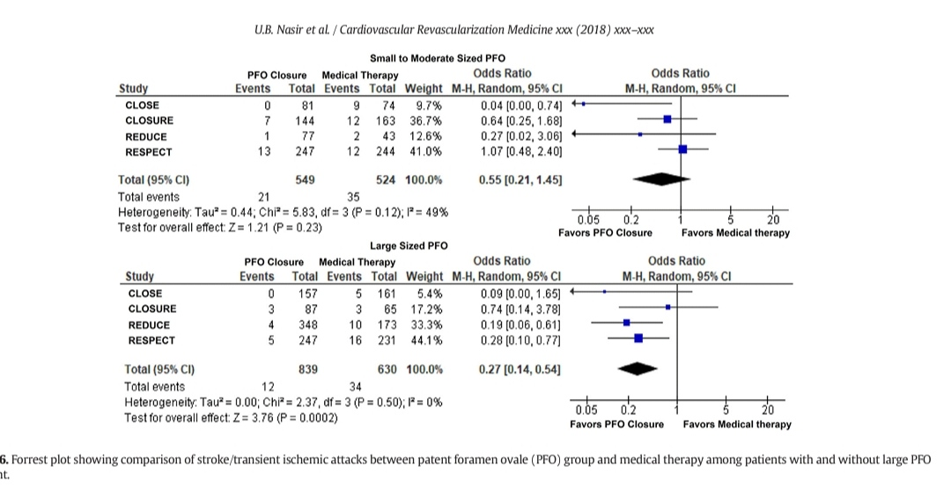

Slide 26
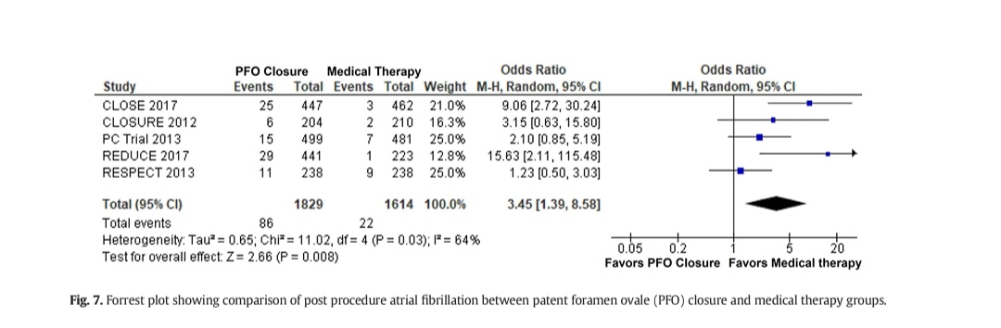

Slide 27
Discussion
PFO CLOSURE SHOWED SIGNIFICANT REDUCTION IN RECURRENT STROKE AS COMPARED TO MEDICAL THERAPY.
LARGE PFO DERIVED MORE BENEFIT.
ATRIAL FIBRILLATION …MAIN ADVERSE OUTCOME IN PFO CLOSURE GROUP ( 60% PERIPRECEDURAL)

Slide 28
LIMITATIONS
Open Label increased the risk of Bias.
NUMBER OF PRIMARY EVENTS WAS RELATIVELY LOW ( e.g; 52 in CLOSURE I trail, 18 in PC ,and 14 in CLOSE trail)
Duration of Follow up…closure (2yrs) and RESPECT (2.6yrs)
Safety and efficacy in patients older than 60 remains unclear.

Slide 29
Recommendations
Following characteristics in PFO pts favours PFO closure;
Age < 60yrs
Embolic stroke topography
Exclusion of other sources of ischemic stroke
A possible , probable or definite likelihood…as per PASCAL classification.

Slide 31
Thank you

